Slide 1

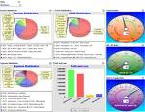
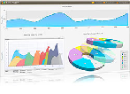
OpenGlass Trade Message Testing Software
NAV
NAV DB
Message configuration
Tester
App API
Forward Parser
Messages
OpenGlass DB
Trade Engine
Admin Module
Reverse Parser
Messages
Admin
Test case comparison module
Tester
Metadata/Semantic Layer
Performance Management
Business analytics
Biz Users

